Slide 1

224 Gb/s
22 nm ASIC implementation
ADC-Based
Wireline Processor
MIMO-OFDM reception with far-end crosstalk cancellation
Target: a fabrication-ready ASIC design package.
Silicon fabrication is outside the project scope.
Basel, team lead and presenter
With Mohamed Ali
Discussion with
Professor Mohamed Radwan
Notes:
Suggested timing: 1 minute. Project goal: implement the referenced MIMO-OFDM work as a useful custom processor in a 22 nm mixed-signal ASIC, deliver a fabrication-ready design package and do not fabricate. Basel is the current team leader and representative. Academic research leadership is still to be agreed with a professor. Discussion participant: Professor Mohamed Radwan. Presenters: Basel and Mohamed. Agenda for a 30-minute review: objective/architecture 5 minutes including cover, system evidence 10 minutes, team 2 minutes, execution plan 5 minutes, discussion 8 minutes. The 224 Gb/s designation is per lane and rounded from the reference configuration. Source: docs/FEXT_MIMO_OFDM_200Gb_paper.pdf, G. Kim, Far-End Crosstalk Cancellation With MIMO OFDM for >200 Gb/s ADC-Based Serial Links, IEEE TCAS-II 70(1), 81–85, January 2023, DOI 10.1109/TCSII.2022.3205246.
Redesign: dark theme with looping GIF illustrations (they play in Slide Show mode) and fade transitions. Cover animation is a conceptual illustration, not evidence of fabricated silicon.

Slide 2
Reference paper and ASIC architecture
ARCHITECTURE
G. Kim, TCAS-II 2023: two-lane MIMO-OFDM for FEXT cancellation
AFE + ADC ×2
Sample alignment
Custom DSP processor
Recovered
Analog circuitry
CP removal
FFT ×2 / MIMO / 64-QAM
data bits
7-bit samples at 75.25 GS/s per lane
ADC input range: 0.5 Vpp differential
Instruction sequencer
Sample and coefficient memory
224 Gb/s
1024 + 8
64-QAM
2 × 2 MIMO
per lane target
FFT points + CP samples
511 active tones per lane
joint lane equalization
Notes:
Suggested timing: 4 minutes. Source: docs/FEXT_MIMO_OFDM_200Gb_paper.pdf, G. Kim, Far-End Crosstalk Cancellation With MIMO OFDM for >200 Gb/s ADC-Based Serial Links, IEEE TCAS-II 70(1), 81–85, January 2023, DOI 10.1109/TCSII.2022.3205246. Source: config/config_224G.m and main_224.m. Current main selects IEEE 802.3ck Channel1 Asic_Mezz_Retimer_L10 THRU/FEXT1 and ADC-input noise. The paper reports architectural simulations, not a fabricated 22 nm processor or a complete programmable instruction set. The team contribution proposed here is hardware architecture, custom processor execution, analog implementation and verified physical closure. Receiver datapath shown: two differential analog lanes, AFE/VGA, ADCs, sample retiming/alignment and CP removal, FFT, 2x2 MIMO equalization and QAM demapping. Channel estimation updates equalizer coefficients. The paper models time-interleaved ADCs and DSP retiming. A programmable processor needs an instruction sequencer, storage and an execution architecture beyond the paper. Final chip boundary, including TX/DAC, clock recovery and FEC, is a review decision and must be frozen by M2. Paper modeled 7-bit ADC/DAC at 75.25 GS/s, 0.5 Vpp differential ADC input, 1024-point FFT, CP 8 and 64-QAM on 511 independent tones. Seven-bit resolution is not a demonstrated seven-bit ENOB at the target input frequency. No PDK, supply voltage, clock frequency or ADC architecture is claimed to be verified.

Slide 3
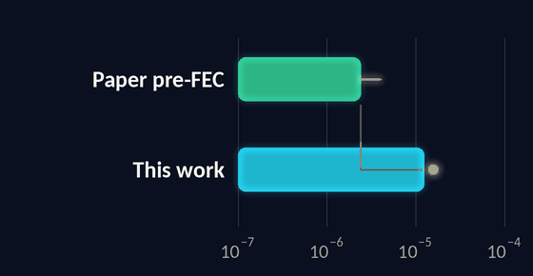
System progress and the remaining gap
MATLAB EVIDENCE
1.24 × 10⁻⁵
5.16×
Three-seed baseline BER
gap to paper BER: 2.4 × 10⁻⁶
1,276 errors / 103,017,600 bits
Evidence | Current result | What remains open
Tests 1–4 Algorithm isolation | QAM reference and OFDM/channel/FEXT paths exercised | Zero observed errors do not establish a cancellation benefit under weak FEXT.
Tests 5–6 Training + impairments | Pilot estimation with converter effects, noise, jitter and clipping | Actual ADC performance and processor execution are not yet represented.
Notes:
Suggested timing: 10 minutes. Source: docs/FEXT_MIMO_OFDM_200Gb_paper.pdf, G. Kim, Far-End Crosstalk Cancellation With MIMO OFDM for >200 Gb/s ADC-Based Serial Links, IEEE TCAS-II 70(1), 81–85, January 2023, DOI 10.1109/TCSII.2022.3205246. Source: config/config_224G.m and main_224.m. Current main selects IEEE 802.3ck Channel1 Asic_Mezz_Retimer_L10 THRU/FEXT1 and ADC-input noise. Quantitative source: results/224G/paper_clipping_confirmation.csv, seeds 31/53/79, L=1000, DAC clipping 12.6 dB and ADC clipping 13.4 dB. Sum 1276 bit errors / 103017600 bits = 1.2386233e-5 BER. Paper pre-FEC BER is 2.4e-6, a ratio of 5.16093. Aggregate SER is 1276/17169600=7.43174e-5 versus paper 1.4e-5. This is current saved simulation evidence, not proof of a hardware implementation. Tests 2–4 have reported zero observed errors in the selected weak-FEXT configuration; that does not establish a cancellation advantage. Main channel/FEXT and noise-reference mismatch prevent an exact paper-reproduction claim. Existing MATLAB is functional; planned arithmetic, cycle and physical models must test overflow, precision loss, sample buffering, memory bandwidth, training and sustained throughput. The modeled frame period is 1032/75.25e9=13.7143 ns. Raw ADC bandwidth is 2*7*75.25e9=1.0535 Tb/s. A 128-sample/channel interface requires at least 587.890625 MHz excluding overhead, only an architectural candidate. No clock, area, power or ADC feasibility is established in 22 nm.
This slide preserves the original MATLAB evidence and gap. The next-proof section has moved to the following slide for readability. Numerical values are unchanged.

Slide 4
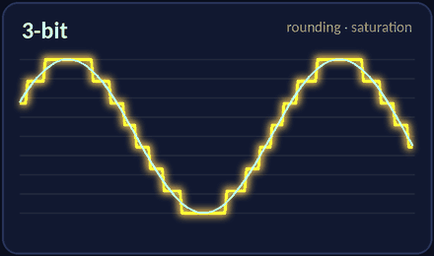
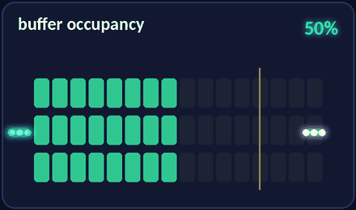
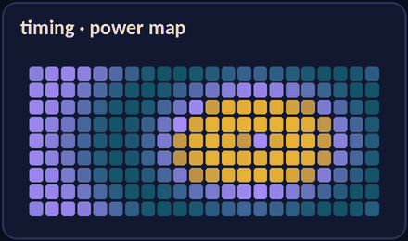
The next proof: algorithm to implementation
VERIFICATION PRIORITIES
01
02
03
Arithmetic model
Cycle model
22 nm evidence
Precision, rounding and saturation against the MATLAB reference.
Parallelism, memory bandwidth and no input-buffer overflow.
ADC characterization and RTL synthesis / timing / power.
Notes:
Suggested timing: 10 minutes. Source: docs/FEXT_MIMO_OFDM_200Gb_paper.pdf, G. Kim, Far-End Crosstalk Cancellation With MIMO OFDM for >200 Gb/s ADC-Based Serial Links, IEEE TCAS-II 70(1), 81–85, January 2023, DOI 10.1109/TCSII.2022.3205246. Source: config/config_224G.m and main_224.m. Current main selects IEEE 802.3ck Channel1 Asic_Mezz_Retimer_L10 THRU/FEXT1 and ADC-input noise. Quantitative source: results/224G/paper_clipping_confirmation.csv, seeds 31/53/79, L=1000, DAC clipping 12.6 dB and ADC clipping 13.4 dB. Sum 1276 bit errors / 103017600 bits = 1.2386233e-5 BER. Paper pre-FEC BER is 2.4e-6, a ratio of 5.16093. Aggregate SER is 1276/17169600=7.43174e-5 versus paper 1.4e-5. This is current saved simulation evidence, not proof of a hardware implementation. Tests 2–4 have reported zero observed errors in the selected weak-FEXT configuration; that does not establish a cancellation advantage. Main channel/FEXT and noise-reference mismatch prevent an exact paper-reproduction claim. Existing MATLAB is functional; planned arithmetic, cycle and physical models must test overflow, precision loss, sample buffering, memory bandwidth, training and sustained throughput. The modeled frame period is 1032/75.25e9=13.7143 ns. Raw ADC bandwidth is 2*7*75.25e9=1.0535 Tb/s. A 128-sample/channel interface requires at least 587.890625 MHz excluding overhead, only an architectural candidate. No clock, area, power or ADC feasibility is established in 22 nm.
This is the original next-proof content, separated from the results table. No new implementation claim is made.

Slide 5
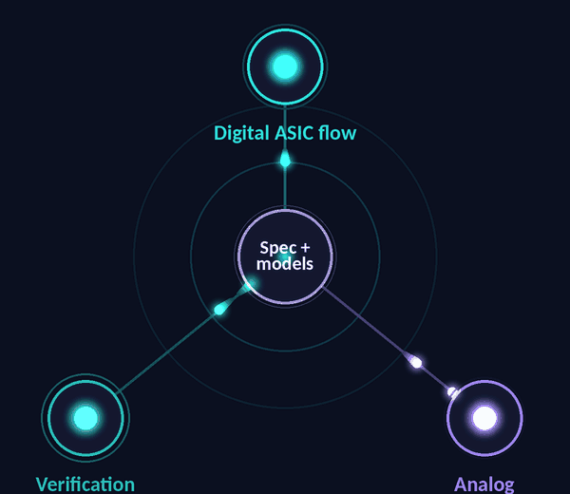
Eight people, three connected workstreams
TEAM RESPONSIBILITIES
Digital ASIC flow
Basel / Nourhan / Mohamed
Processor architecture and RTL, synthesis, DFT, place and route, timing and power closure.
Verification
Omar / Islam
MATLAB reference and testbenches, arithmetic/cycle comparisons, regressions, coverage and mixed-signal checks.
Analog
Kareem / Fahd / Menna
ADC/AFE and required clocking, transistor simulations, layout, DRC/LVS and extracted-model characterization.
Basel
Team lead and current representative
Specifications, integration, technical reviews and coordination. Academic research leadership to be agreed with a professor.
I will be replaced with the professor after getting to a perfect argument about the project
Notes:
Suggested timing: 2 minutes. Digital ASIC flow: Basel, Nourhan, Mohamed. Verification: Omar, Islam. Analog: Kareem, Fahd. Basel is the current team leader and representative as well as a digital ASIC contributor. Academic research leadership is not assigned to Professor Mohamed Radwan by this deck; the team is seeking an opportunity for a professor to guide the research and paper. Detailed individual block ownership can be agreed after the architecture review, rather than invented here. Verification owns the independent MATLAB reference and test/coverage work with DSP test cases. A shared specification, model exchange and interface agreement connect the three tracks. Weekly reviews and issue tracking are proposed working practices, not completed milestones.

Slide 6
Our tools, one shared implementation flow
HOW WE WORK TOGETHER
DIGITAL
VS Code
SpyGlass
QuestaSim
Synopsys
Digital P&R
Write RTL
Linting
Simulation + tests
Synthesis
Tool setup to confirm
ANALOG
Virtuoso
Circuit verification
Virtuoso layout
ADC/AFE schematics
Transistor-level simulation
Analog block + extracted model
Shared reference: MATLAB test vectors → QuestaSim checks → versioned block handoffs
Same 22 nm PDK and compatible libraries; agree pins, data format, clocks and voltage levels.
Notes:
User-confirmed tool choices: VS Code for RTL, SpyGlass for linting, QuestaSim for simulation/testing, Synopsys for synthesis, Cadence Virtuoso for analog and intended physical integration, 22 nm technology. Synopsys is a vendor; the exact synthesis product was not specified. Confirm the digital P&R capability: standard Virtuoso access alone does not identify a complete digital implementation license. Cadence Virtuoso Digital Implementation uses Genus and Innovus technology; alternatively the lab may provide a separate P&R tool. The analog simulation engine, mixed-signal co-simulation setup, and signoff tools are not yet identified. Do not imply that QuestaSim alone verifies transistor-level analog behavior. Sources: user conversation; https://www.cadence.com/en_US/home/tools/digital-design-and-signoff/soc-implementation-and-floorplanning/virtuoso-digital-implementation.html ; https://www.synopsys.com/implementation-and-signoff/rtl-synthesis-test/design-compiler.html . Workflow proposal: keep source RTL, testbenches, scripts and interface documents in version control; use the lab-supported library-management method for Virtuoso databases.

Slide 7
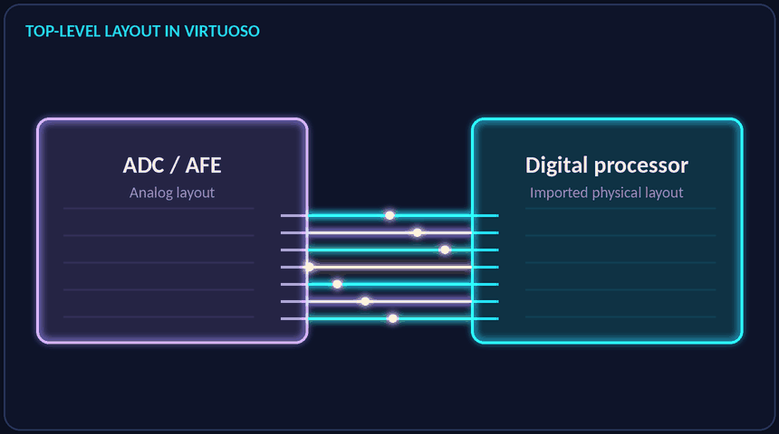
One chip: analog and digital meet in layout
PROPOSED INTEGRATION FLOW
Analog team
Virtuoso ADC/AFE layout
Circuit netlist + interface model
Digital team
Placed-and-routed digital layout
Gate-level netlist + timing constraints
Block handoff
GDSII/OASIS + netlist
Pin map + models / constraints
Whole-chip checks
Metal routing connects data, clocks and supplies.
DRC / LVS, extracted behavior,
timing and power integrity
Notes:
Proposed analog-on-top integration flow, to be confirmed with the lab. The digital team delivers a physical layout from the chosen P&R tool plus netlist, timing constraints and a consistent pin map. Import the digital physical block into the same foundry-process environment used by the analog team. At schematic level, use a symbol and appropriate netlist/model views; at layout level, use the physical block. Connect both at the top level and perform full-chip checks. Use matching layer maps, library cell views, naming and supply conventions. GDS merge/import does not by itself prove electrical correctness. LEF abstracts describe footprint, pins and routing obstructions when a digital P&R top level is used; Liberty timing views are needed where applicable. The alternative digital-on-top method places analog hard macros in a P&R tool. Source: https://www.cadence.com/content/dam/cadence-www/global/en_US/documents/services/ams-methodology-ov.pdf ; https://support1.cadence.com/public/docs/content/20510739.html . First integration milestone proposal: prove the file handoffs with a small digital test block and an analog test block before full receiver implementation. Confirm analog simulation, mixed-signal and physical signoff licenses separately.

Slide 8

Release criteria and review decisions
PROFESSOR DISCUSSION
Fabrication-ready design package
Decisions for this review
Digital closure
01
ASIC boundary
Verified processor RTL/netlist, DFT, corner timing and activity-based power.
Receiver or full TX/RX; clock recovery, FEC, I/O and packaging responsibilities.
Analog closure
02
22 nm feasibility
Extracted ADC/AFE characterization, PVT/mismatch and clock-interface checks.
Confirm PDK, libraries, signoff access and ADC / processor performance budgets.
Physical signoff
03
Research leadership
Top-level DRC/LVS, EM/IR, final layout and qualified reports / approved waivers.
Agree academic guidance and the contribution to evaluate for publication.
Release archive
04
M2 acceptance gate
GDSII/OASIS, netlists, views, constraints, test access and documented I/O assumptions.
Approve evidence, owners and a review date before committing to full-rate closure.
Notes:
Suggested timing: 8 minutes. Project goal is a real ASIC design prepared for use and fabrication, with no fabrication performed. This slide describes acceptance criteria, not work already achieved. Qualified release requires the selected foundry/PDK flow and complete approved scope: analog macros and full-chip connectivity, extracted simulations, RTL/netlist verification, DFT/test access, reset/clock/CDC checks, multicorners static timing, area/power/EMIR evidence, clean DRC/LVS or approved foundry waivers, GDSII/OASIS, final netlists, constraints, pin/pad/package assumptions, documentation and reproducible reports. The exact PDK, standard cells, memory/IO availability and signoff decks remain unconfirmed in the project. Confirm whether receiver-only or full transceiver including TX/DAC is the required boundary, and explicitly settle clock recovery, FEC and IO/package responsibilities. Confirm professor-led research supervision without claiming that Professor Mohamed Radwan has already accepted. Freeze a testable research contribution after literature review; reproducing a published algorithm alone is not a novelty claim. The first two-week review should present the tool/PDK manifest, requirements and interfaces, numerical-reference checks, ADC/clock feasibility budgets and critical processor synthesis results, with named owners and next review date. All 400 Gb/s or DFE/supply-aware extensions are outside the mandatory baseline presented here.
The ten-month execution-plan slide has been removed at the user’s request. The original M2 acceptance-gate review item is preserved as a decision, without adding a replacement schedule.

